Slide 1
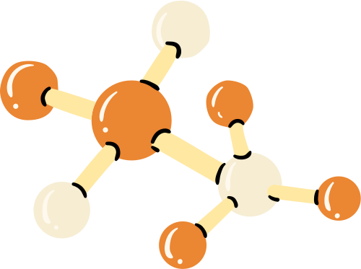

TRANSPOLYMER
INTRODUCTION:
TransPolymer is a Transformer-based language model designed for polymer property prediction by using SMILES tokenizer and Masked Language Modeling (MLM) pretraining to enhance accuracy and efficiency.
SCOPE OF PROJECT:
TransPolymer uses AI to revolutionize polymer research , making it easier , faster , and more accurate to predict how different polymers will behave .
USERS:
🔸Material Scientists 🔸Polymer Chemists 🔸Computational Chemists 🔸R&D Engineers
🔸Data Scientist in Material Informatics 🔸Input and Output

Slide 2
Pain Points:
TECH STACK:
🔸 Needs high-quality data
🔸 External factors (temperature,
aging) not always captured
🔸 High computational power required
🔸 Struggles with unseen polymers
🔸MERN Stack
🔸Python
🔸PyTorch
🔸Hugging Face Transformers 🔸RDKit and Scikit-learn
🔸NumPy, Pandas and Matplotlib.
01
02
Business Case:
Roles Involved:
🔸Cuts Costs & Saves Time
🔸Speeds Up Material Discovery
🔸Better Decisions with Data
🔸Gives Companies an Edge
03
04
🔸Researcher/User
🔸End Users(Polymer
Engineers/Chemists)

Slide 3
Dataset and Data Source:
We created a custom dataset which contains 6 polymer properties. The dataset was created by referring the information extracted from GitHub repositories related to polymer science.
Cloud Deployment:
🔸Train & Store → Train on Cloud GPUs, store in S3/GCS.
🔸Deploy API → Use FastAPI/Flask, deploy via Docker (K8s, Lambda, Cloud Run).
🔸Frontend → React/Vue + JWT auth for secure access.
🔸Monitor & Scale → Prometheus + Grafana, auto-scale with K8s/Cloud Run.
Data Preprocessing :
🔸Verification (Check if the Data is Correct)
🔸Validation (Ensure Data is Meaningful & Usable)
🔸Normalization (Standardizing Data for Better Model Performance)

Slide 4
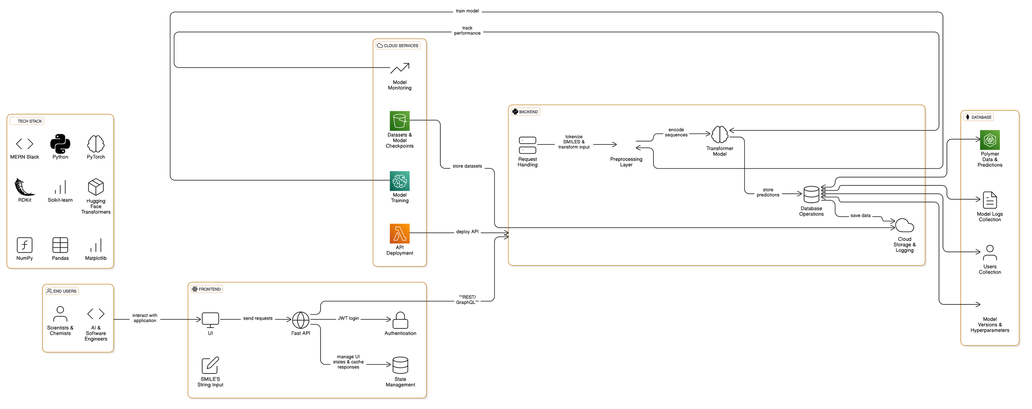
3

